Slide 1
ML for Gender identification
Sergio Gonzalez

Slide 2
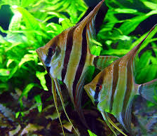
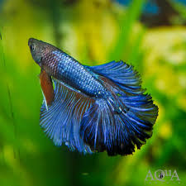
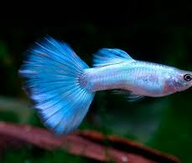
Gender
In some fish gender is easy to tell: - longer fins, Vibrant colors
While others (Angelfish, Catfish) hard to tell…

Slide 3
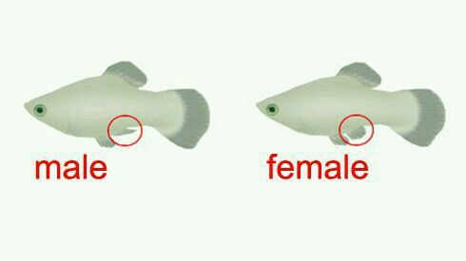
How can we tell….
With time or by looking closely…
Can be troublesome!!

Slide 4
ML for gender classification
I want to create an app that will help new fish keepers meet their new fish!
First: Take a picture of fish name\of the actual fish… n through ML classification, basic information pops up! (home)
Second: Record the fish for a couple seconds… gender is revealed!!

Slide 5
What Gender
Project focus was step (2), is ML classification good for gender identification on fish
Picture vs Record…
How many pictures in a recording

Slide 6
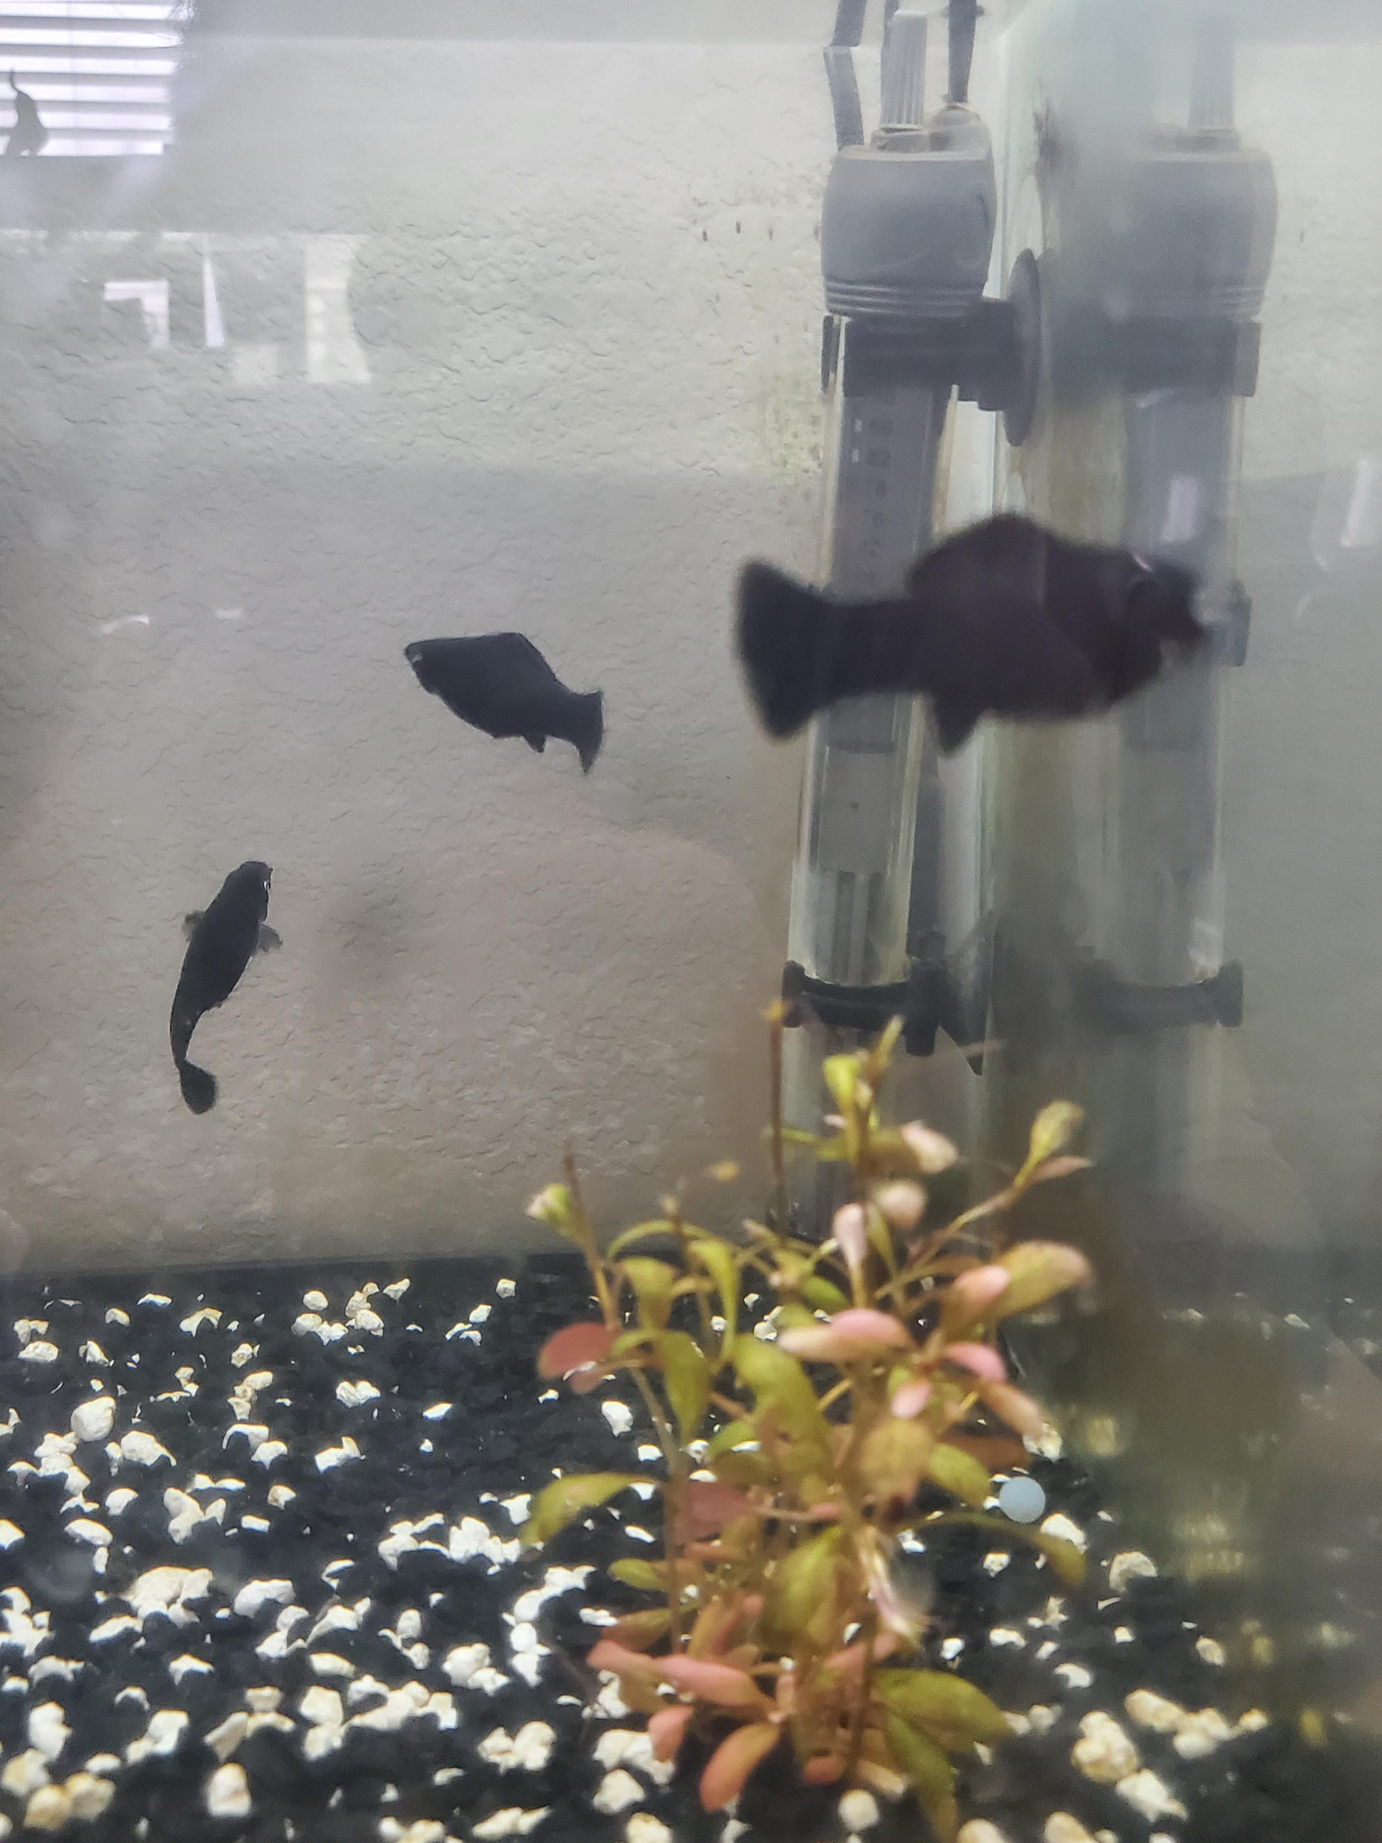
Steps taken
Frame_ID | Class
Frame1.jpg | 0 (neither)
“ “ | 1 (male)
 | 2 (female)
 | 3 (both)
Collect data (dalmatian molly)
Extract frames (pictures) from the video
Label the classes

Slide 7

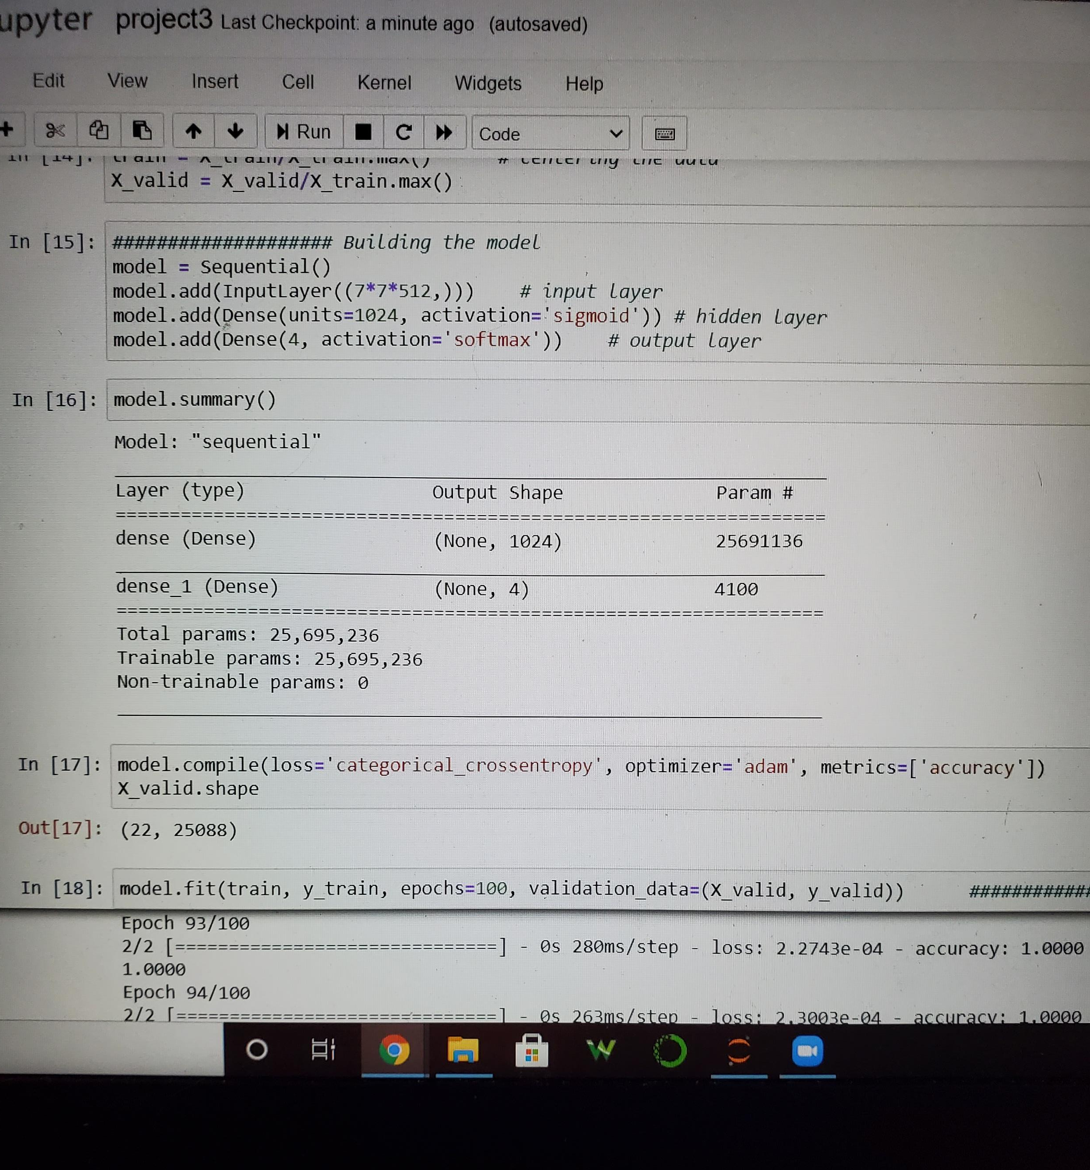
Video classification
Use extracted frames to; create training and validation sets (pre trained - VGG16)
Train model, evaluate model on validation (we know the answers)
Use trained model on new (unlabeled data)
Easy Right!

Slide 8
Findings → model predicted 80% of test images correctly.

Slide 9
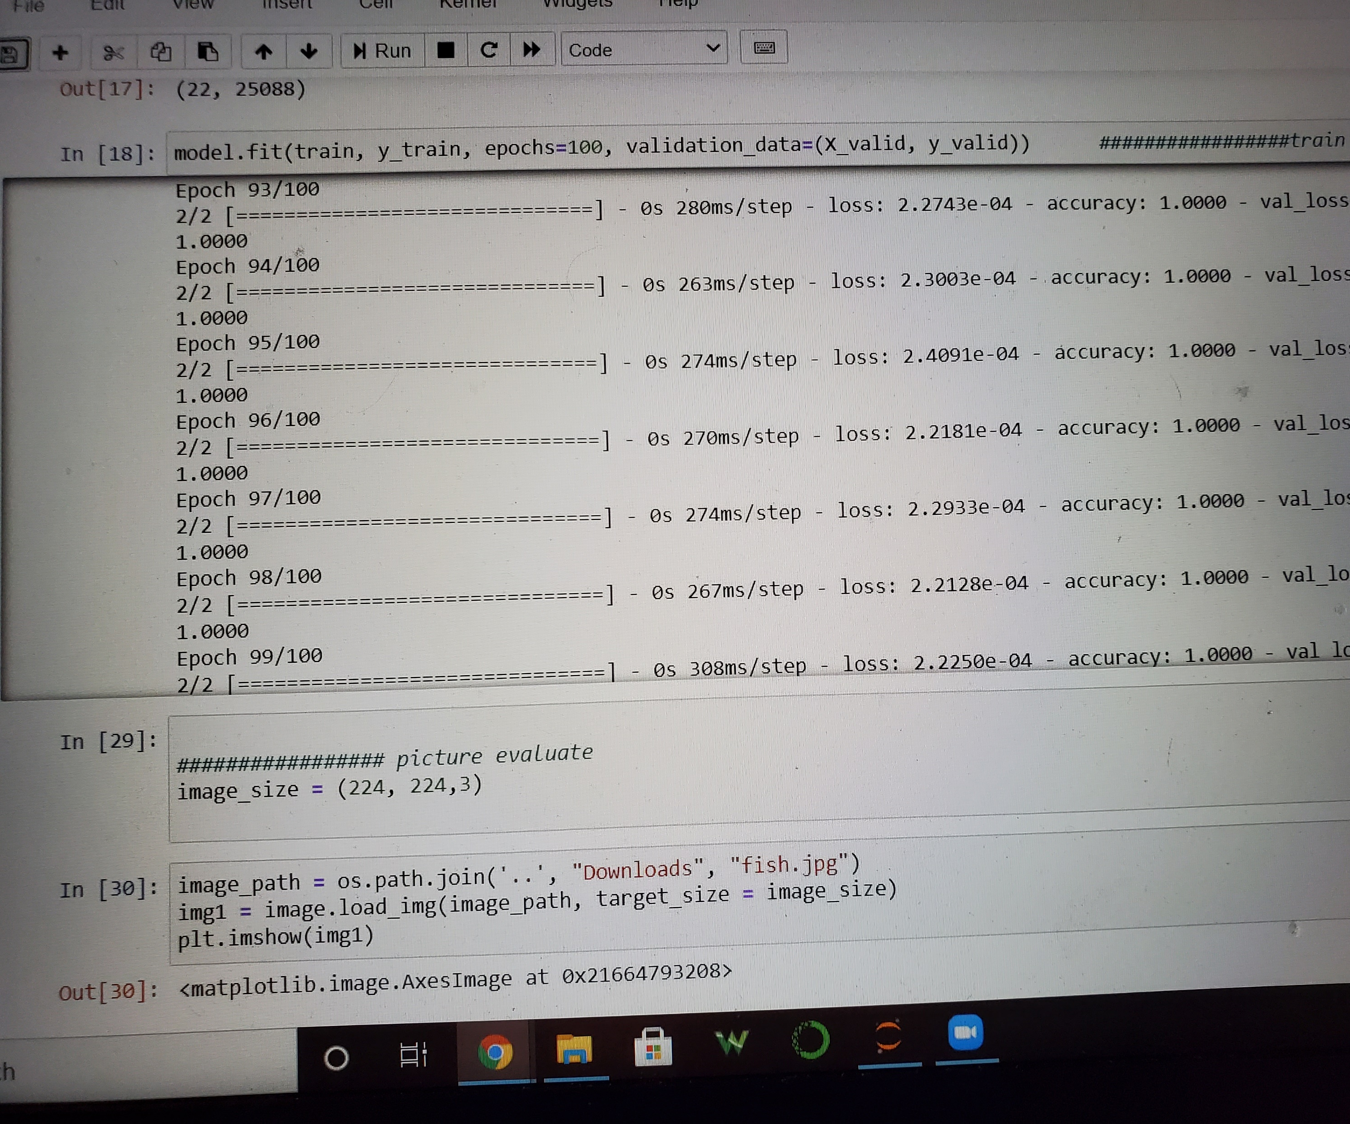
Problems
Problems yes… but did I cry… yes

Slide 10

Conclusions
Add weights, features, tracker to increase accuracy
Remove aquarium background (plants, etc) –
Bigger data set

